Slide 1
Distributed Inference using Apache MXNet (incubating) and Apache Spark Naveen Swamy Software Developer @ Amazon AI wamy@amazon.com

Slide 2
Outline
Review of Deep Learning Concepts.
Apache MXNet (incubating) DL Framework.
Distributed Inference using MXNet and Spark.

Slide 3
Machine Learning
Use of Algorithms to learn patterns from raw data and make decisions.
Solve problems that can be described formally.
Example: Spam Filter
Drawbacks:
Carefully handcrafted features.
Domain Experts to craft features.
Error prone
Does not work new problems.
Notes:
Early days of AI solved problems that could described by formal mathematical rules but harder for humans to solve. Eg: Board Games
Today's AI tries to solve problems that are easy for humans to solve intuitively but harder to describe formally for example: Object detection.

Slide 4
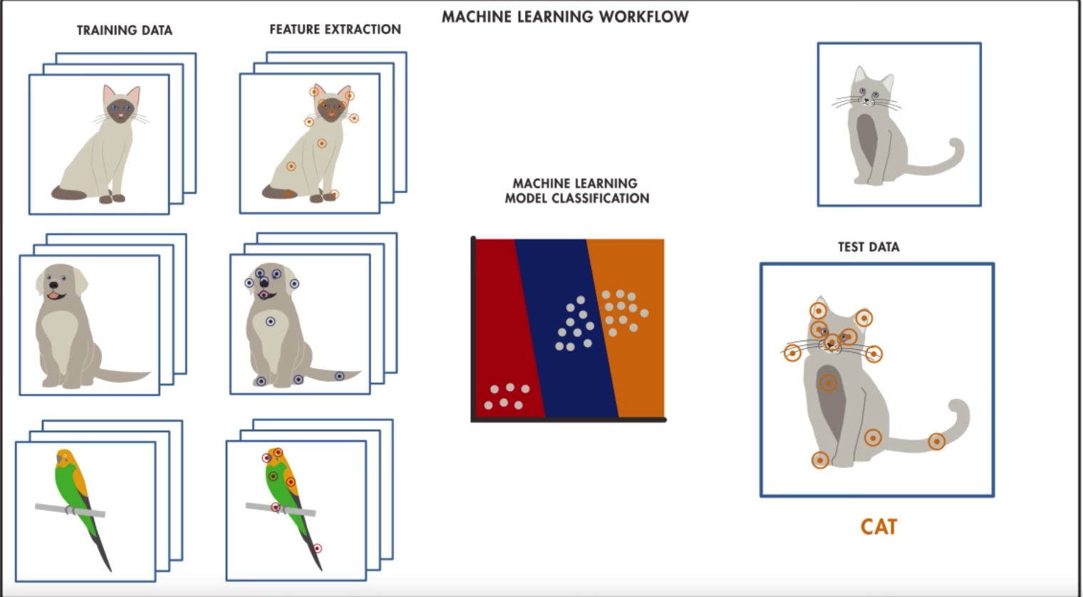
Credits: Matlab ML vs DL

Slide 5
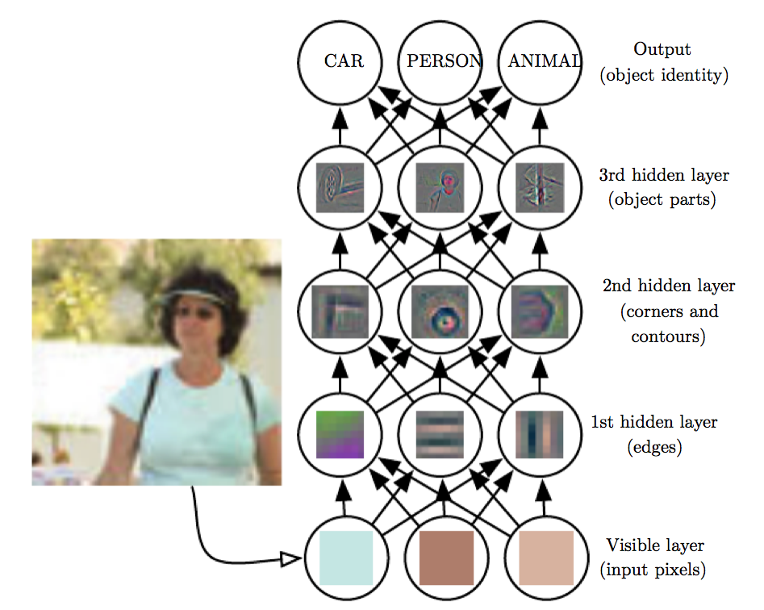
Deep Learning
Layers of neurons learning hierarchy of concepts.
A System that learns important features.
Credits: Deep Learning Book – Ian Goodfellow, etal
Notes:
Learn from experience and understand in terms of hierarchy of concepts.
Building one concept at a time. As the hierarchy grows, the graph of these concepts grows deeper with many layers giving you a large neural network.

Slide 6
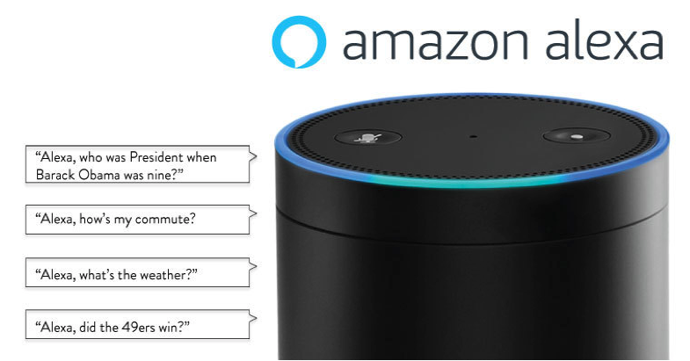
Deep Learning Applications
Autonomous Driving
Speech Recognition
Machine Translation
Diagnose Heart Disease
Greatest Intellectual Game

Slide 7
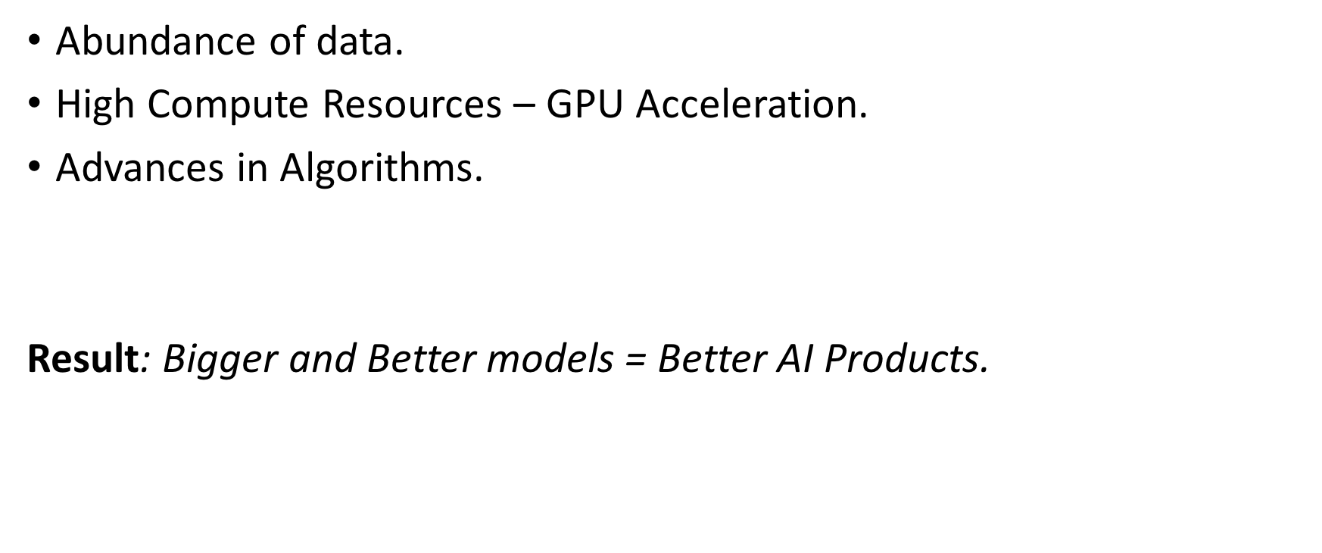
Rise of Deep Learning
Data
Abundance of data.
High Compute Resources – GPU Acceleration.
Advances in Algorithms.
Result: Bigger and Better models = Better AI Products.
GPU
Algorithms
Notes:
Abundance of Data – Deeper Networks
Digitization of our every day life. There are many many apps and websites offering free digital services in exchange they collect data about ourusage patterns
High Compute Resources – GPUs - Faster experiments.
GPUs have hundreds of cores and can run thousands of operations in Parallel.
Advances in Algorithms – Makes Learning Faster

Slide 8
Training & Inference
Credits: NVidia deep learning blog
Notes:
Deep Learning consists of 2 phases: Training and Inference

Slide 9
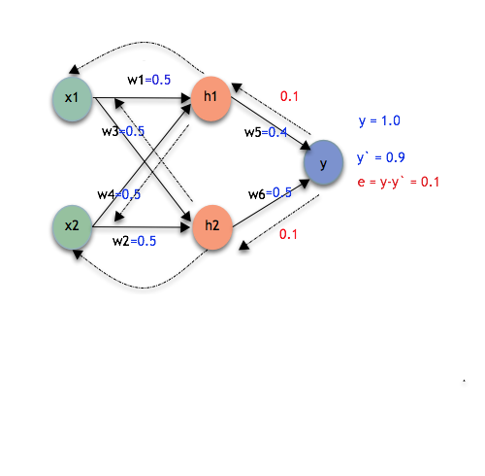
Training Neural Networks
Pass data through the Neural Net – Forward pass.
Define an objective – Loss function.
Send the error back – Backward pass.
Model: Output of Training a neural network.
Notes:
How does learning happen ?
Feed the neural networks with data and see what output it produces – this is also called forward propagation
Verify against the desired output, if it does not meet propagate back the error.
Continue the process till it meets the objective

Slide 10

Deep Learning Inference
Use Pre-trained model in your application with new data.
Online/Offline Inference
Notes:
Using pre-trained models with new data on a pre-trained neural network(model) to get predictions. Its basically only a forward pass.
Online(Real time) Inference: tasks that require immediate feedback(example: fraud detection).
Offline Inference: pre-computations, inference on large datasets, etc.,

Slide 11
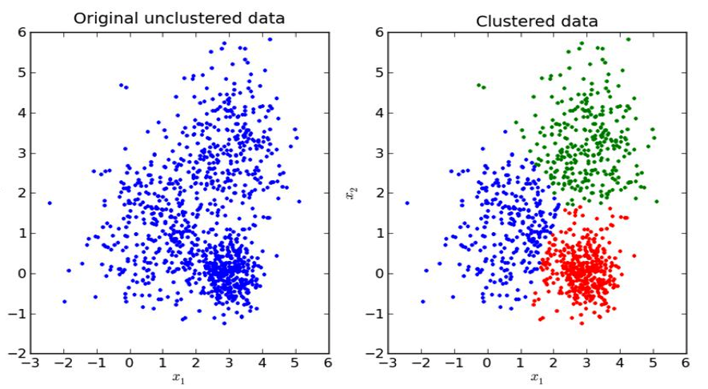
Types of Learning
Supervised Learning –Uses labeled training data learning to associate input data to output.
Example: Image classification, Speech Recognition, Machine translation
Unsupervised Learning – Learns patterns from Unlabeled data.
Example: Clustering, Association discovery.
Notes:
Learns from Labeled Data points,

Slide 12
Types of Learning
Reinforcement Learning: Agent & Environment Interaction based on policies.
Learns using rewards and feedback to learn optimal policies.
Example: Games, Robotics

Slide 13
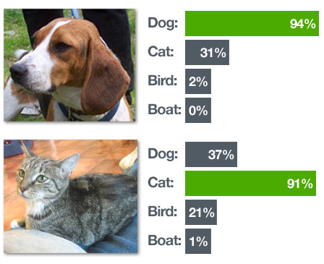
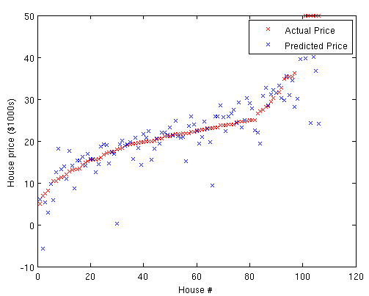
Supervised Learning Tasks
Classification: Categorize output into one or more classes(discrete number of values)
Example: Image detection: dog/cat/car
Regression: Learn the target output which is a continuous value.
Example: Predict House price.

Slide 14
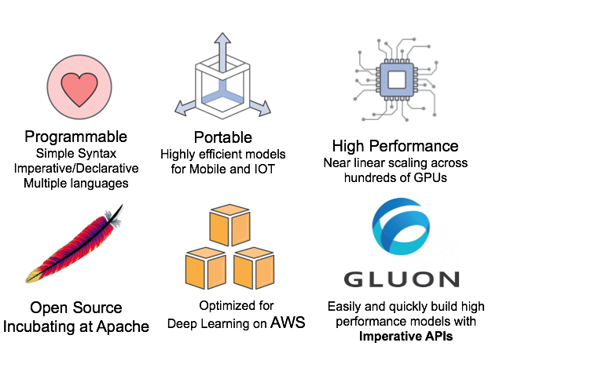

Apache MXNet (incubating)
High Performance
Near linear scaling
across hundreds of GPUs
Most Open
Best On AWS
Accepted into the
Apache Incubator
Optimized for
deep learning on AWS

Slide 15
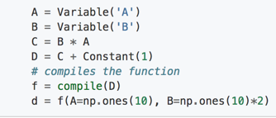
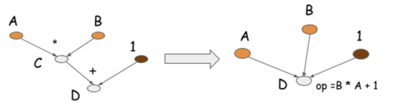
MXNet Concepts – NDArray & Symbol)
NDArray– Tensor(Multi-Dimensional Array) Operations that work on both CPU and GPUs.
Symbol APIs – similar to NDArray operations but adopts declarative programming for optimization.
Imperative programs perform computations as you run them.
Symbolic programs defines the abstract function first, compile and run it with real data.
Computation Graph
Symbolic Program
Notes:
NDArray: Imperative Tensor operations
When the program encounters the statement c = b * a, it runs the actual numerical computation.
In the Symbolic example above, the operation C = B * A generates a computation graph, numerical computation only occurs in the last line of code after you compiled and feed the data.
Obviously Imperative programs are easier to program and debug, you can reason about the intermediate variables, print them but Symbolic program tends to help with Optimization.

Slide 16
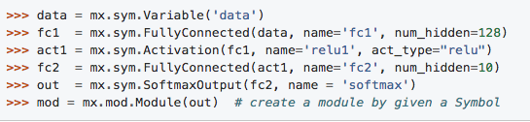
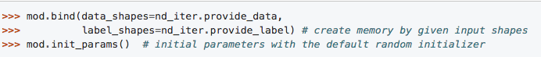
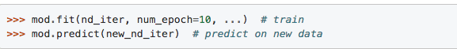
MXNet Concepts – Module
High level APIs to work with Symbols.
Create a Graph
Bind
Pass Data
Notes:
Module represents a computational component that can execute forward and backward operations on a Symbol and update parameters for the Symbol.

Slide 17
Distributed Inference(Offline)
Use-cases
Inference on Large Datasets.
When Pre-computations are needed(latency critical applications) such as recommender systems.
Backfilling Inference on Historic data with the state of the art models.

Slide 18
Challenges
Cluster setup and management
Resource and job management
Deep learning setup
Notes:
Distributed Cluster enables high throughput – data partitioning, batch and task parallelization
The challenges are similar to prevalent distributed data processing systems.
Cluster setup and management: Setting up and monitoring nodes, maintaining high availability, deploying and configuring software packages, and more.
Resource and job management: Scheduling and tracking jobs, partitioning data and handling job failures.
Deep learning setup: Deploying, configuring and running deep learning tasks.

Slide 19


Distributed Inference = MXNet and Spark
Apache Spark is a cluster computing framework.
Enables a variety of distributed data processing.
Efficient data handling.
Integrates with Hadoop and Big data tools.
Notes:
Spark efficiently partitions data across the cluster to parallelize processing.

Slide 20

Components of a Spark Application
Credits: Apache Spark Docs
Notes:
Spark Driver: runs the user’s main program by splitting into jobs and scheduling on one or more executor processes for parallel execution.
Spark Job: A spark job is divided into stages and stages further into tasks. Tasks are smallest unit of work in Spark. Tasks run the same code on every partition. Spark Partition is a logical chunk of distributed data.
Spark Executor: Each Spark application gets a executor and runs tasks in multiple threads.
Cluster Manager: Supports variety of cluster managers(Example: YARN, Apache Mesos, etc.,)

Slide 21
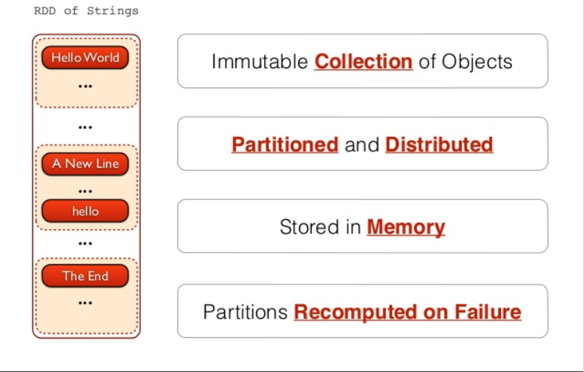
Spark Concepts
Resilient Distributed Dataset (RDD):
RDD is an immutable distributed collection of objects partitioned across the cluster that can be operated on in parallel.
Credits: Apache Spark & Streaming -Fernando Rodriguez
Notes:
RDD is Spark’s abstraction to work with Data. In-Memory dataset
How is RDD different from HDFS files ?
RDD manages redudancy
Spark Dataset and DataFrame: Dataset is also a distributed collection of data built on top of RDDs providing the benefit of Spark SQL.
A DataFrame is a Dataset organized into named columns. Use DataFrames when you have structured data.
Transformation does not evaluate until it sees an Action.

Slide 22
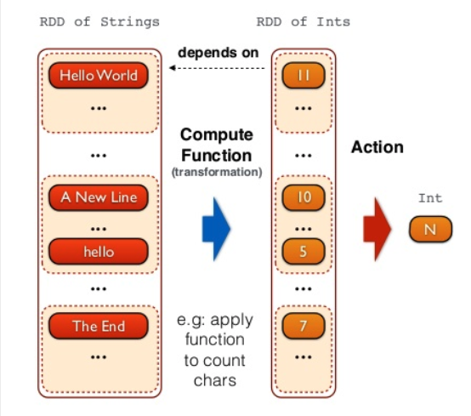
Spark – Transformation and Action on RDDs
Transformation and Actions on RDDs:
Transformation operates on one RDD and creates another RDD.
Action computes the result on an RDD.
Transformations are lazily evaluated.
Credits: Apache Spark & Streaming -Fernando Rodriguez

Slide 23
Distributed Inference(Demo)
ImageNet trained Resnet-18 Classifier
For demo purposes we’ll use publicly available CIFAR-10 test images.
PySpark on Amazon EMR
This example uses CPUs but can be easily extended to GPUs.
Notes:
ImageNet is a database of 1million Images that belong to 1000 categories.
CIFAR-10 is a collection of 60,000 images that belong to 10 different classes.
Create an RDD of Keys and create partitions of mini-batch size

Slide 24
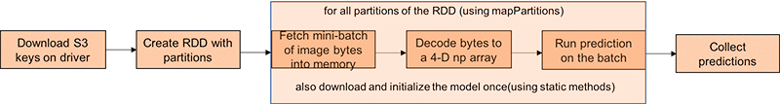
Distributed Inference Pipeline

Slide 25
Distributed Inference using MXNet and Spark
Set up MXNet and Spark on Amazon EMR.
Initialize Spark application.
Load and partition data on the cluster.
Fetch and load data into Spark executors.
Inference using MXNet on the executors.
Collect predictions.

Slide 26
MXNet and PySpark, things to remember:
Configure Your Spark application to create one task per executor and let MXNet handle the CPUs.
No need to first download on the driver, let the tasks fetch a mini-batch of data directly from S3.
Load the Symbol once using static methods – Spark does not have executor init routines.
With PySpark, import the modules (numpy, mxnet, pillow, etc.,) inside the mapPartition function instead of at the top of the file
Notes:
Spark creates one task per core on the executor, MXNet has built in parallelism to utilize all CPUs.
S3 or any distributed File System like HDFS is accessible on all nodes, no need to download to driver and then pass it to the executor.
Spark has no init routine
Import inside the map/mapPartition methods and make sure your libraries are available on all the nodes.

Slide 27
Summary
Deep Learning Concepts
Phases of Deep Learning: Training & Inference
Types of Learning – Supervised/Unsupervised/Reinforcement
Supervised Learning Tasks – Classification/Regression
Apache MXNet
NDArray/Symbol/Module
Apache Spark Concepts
Driver/Executor/RDD
Distributed Inference with MXNet and Spark

Slide 28
Resources/References
Blog- Distributed Inference using MXNet and Spark
Apache MXNet Gluon Tutorials
The Deep Learning Book
Apache MXNet – Flexible and efficient deep learning.
MXNet – Using pre-trained models
Amazon Elastic MapReduce
Apache Spark – Lightning-fast cluster computing
Spark Cluster Overview
Submitting Spark Applications

Slide 29
Thank You
Naveen Swamy
Software Developer, Amazon AI
wamy@amazon.com

